Slide 1
DJANGO WEB FRAMEWORK
DJANGO
Prajwal S – 19BCE10240

Slide 2
What is a Web Framework?
A Web Framework is a server-side application framework that is designed to support the development of dynamic websites, web applications, web services and resources.
They provide tools and libraries to simplify common web development operations.

Slide 3


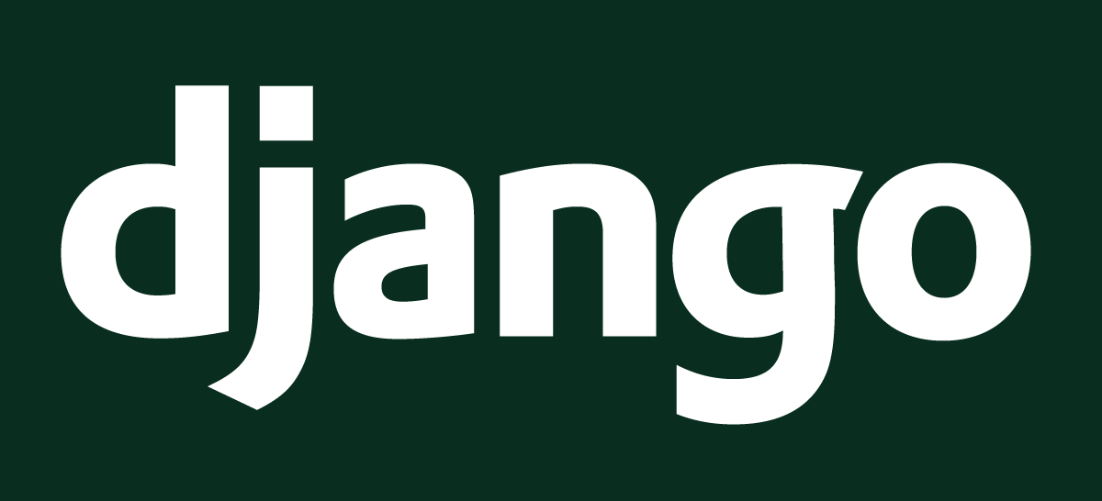
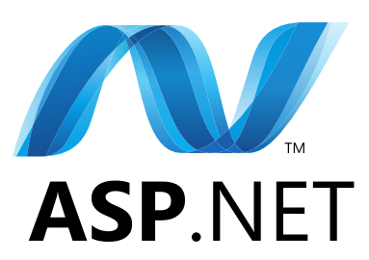
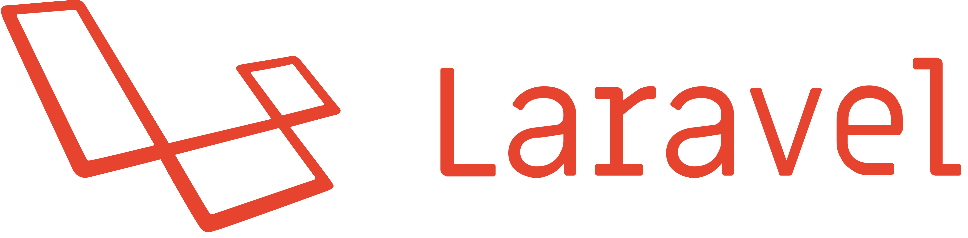
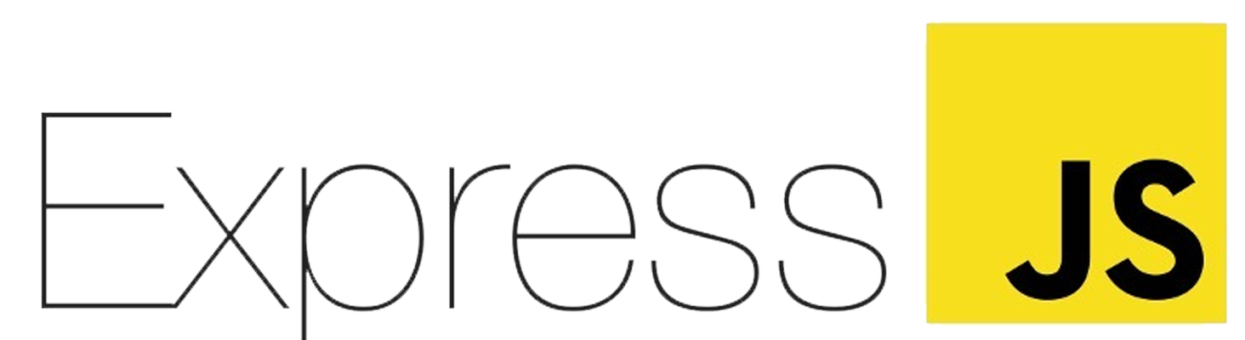
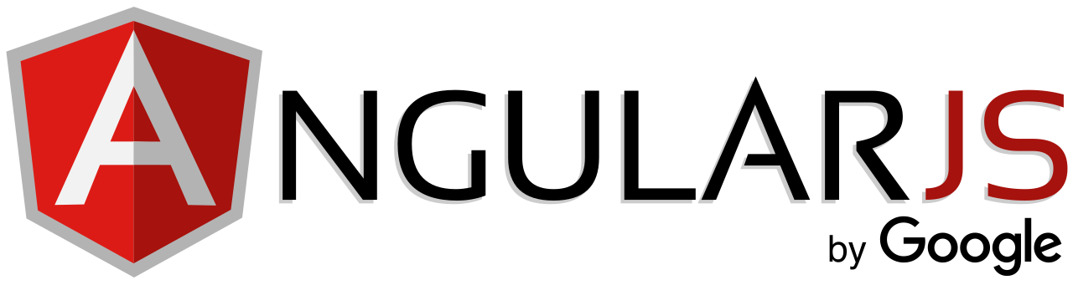
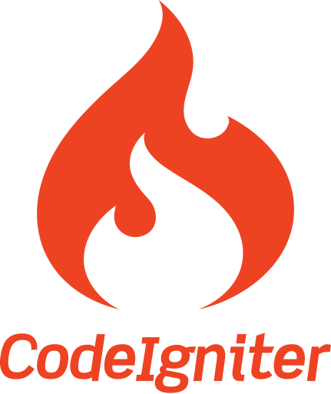
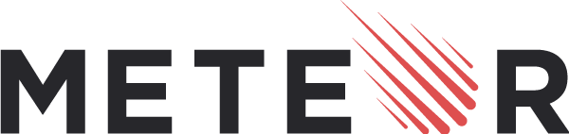
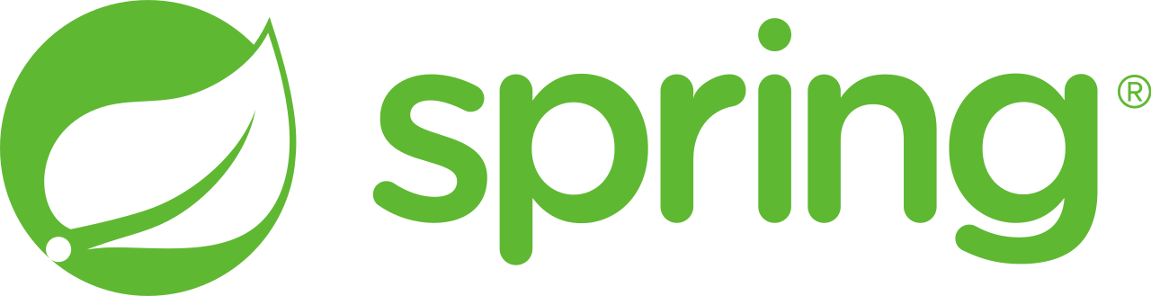
Different Web Frameworks

Slide 4
Why Django?

Slide 5
What is Django?
Django is pronounced “JANG-oh”. The “D” is silent.
It is a High-Level Python Web Framework.
A Python Web Framework is a code library that makes the life of a web application developer much easier for building flexible, scalable and maintainable web applications with clean and pragmatic designs.
Also called “The web framework for perfectionists with deadlines”.

Slide 6

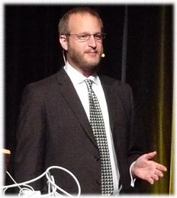
History of Django
Developed by Adrian Holovaty and Jacob Kaplan-Moss for efficient and rapid web development.
Open sourced in 2005.
First Version released September 3, 2008 and has been improving ever-since with new updates.
Jacob Kaplan-Moss
Adrian Holovaty

Slide 7
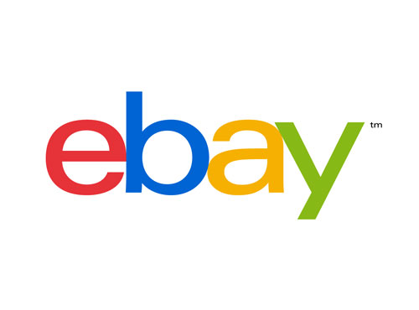

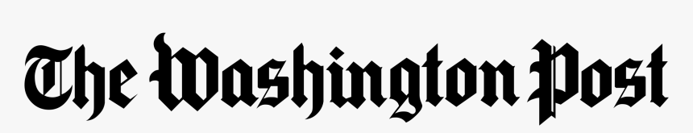
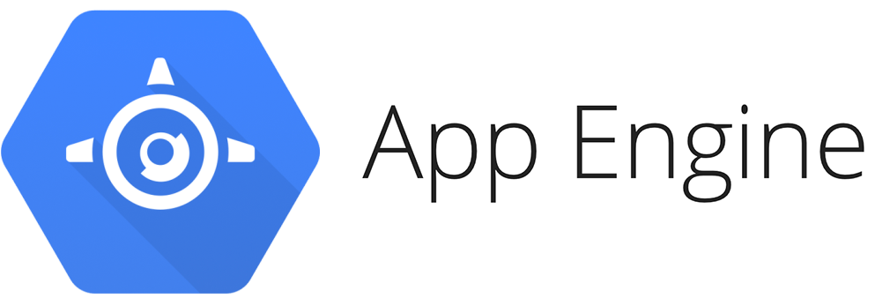
Primary Focus:
Dynamic and database driven websites
Content based websites
Example:
Websites (Washington Post, eBay, Craigslist)
Google App Engine

Slide 8
Features of Django
Excellent Documentation
Python Based
SEO Optimized
High Scalability
Versatile in Nature
Thoroughly Tested
Rapid Development
High Security

Slide 9
Django Architecture
Model-View-Controller (MVC) :
It is a software design pattern that is used to implement user interfaces and gives emphasis on separating data representation from the components which interact and process the data.
Model-View-Template (MVT) :
This is yet another design pattern similar to MVC. It is also used for implementing web interfaces and applications but in contrast to MVC, the controller part is taken care for us by the framework itself.

Slide 10
Django Architecture
Models
- Describes your data structure/database schema
Views
- Controls what a user sees
Templates
- How a user sees it
Controller
- The Django Framework
- URL parsing

Slide 11
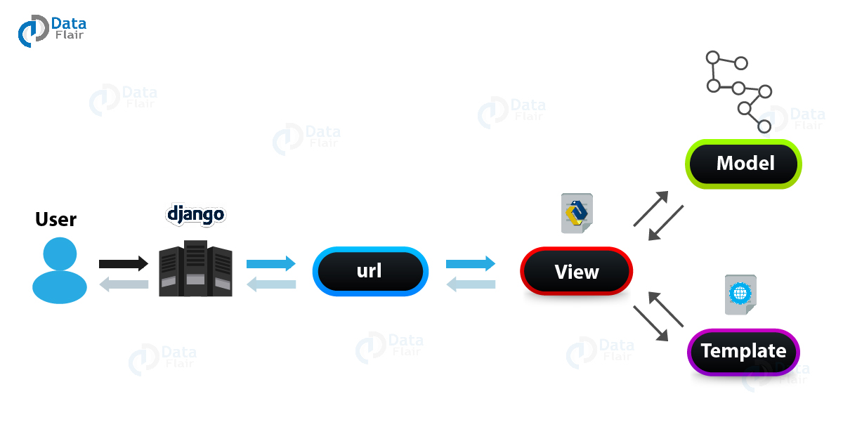
Django Architecture Diagram

Slide 12
Requirements
Python
Code Editor / IDE
Django
CMD / PowerShell / Terminal

Slide 13
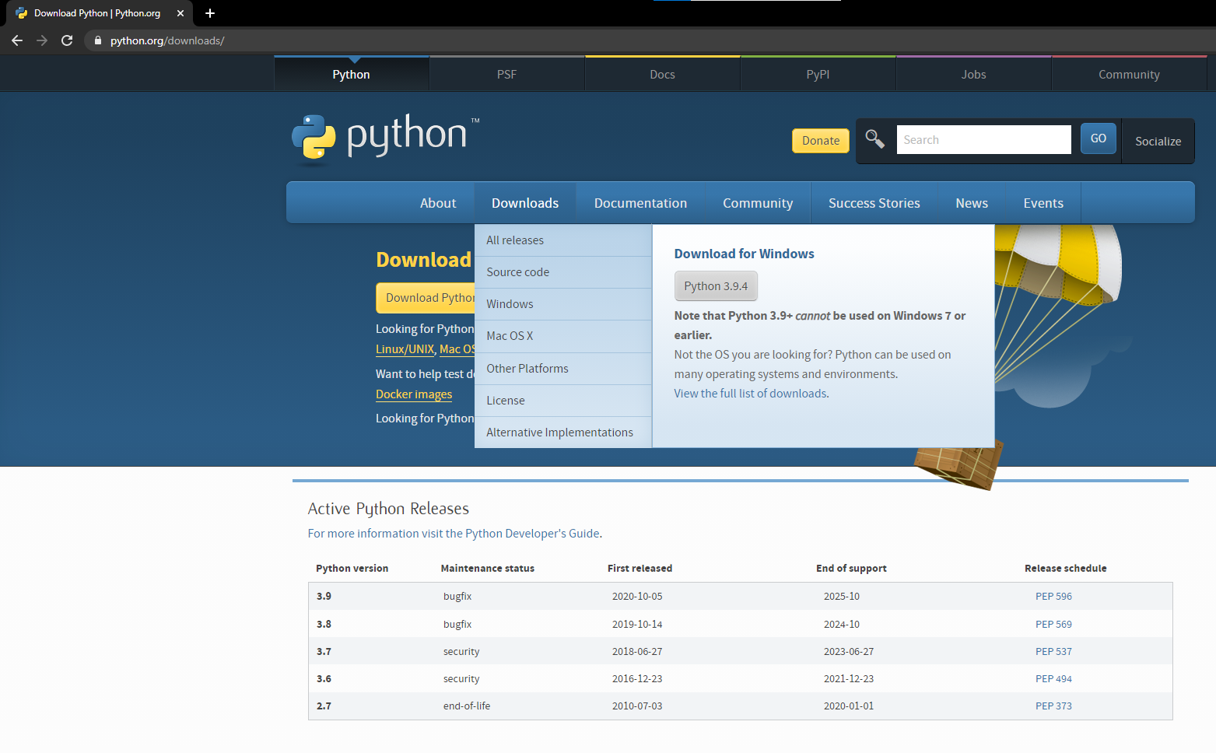
Installation - Python
https://www.python.org/downloads/

Slide 14
Installation - Django
Creating a Virtual Environment (Opt)
pip install virtualenvwrapper-win
mkvirtualenv test
workon test
pip install django

Slide 15
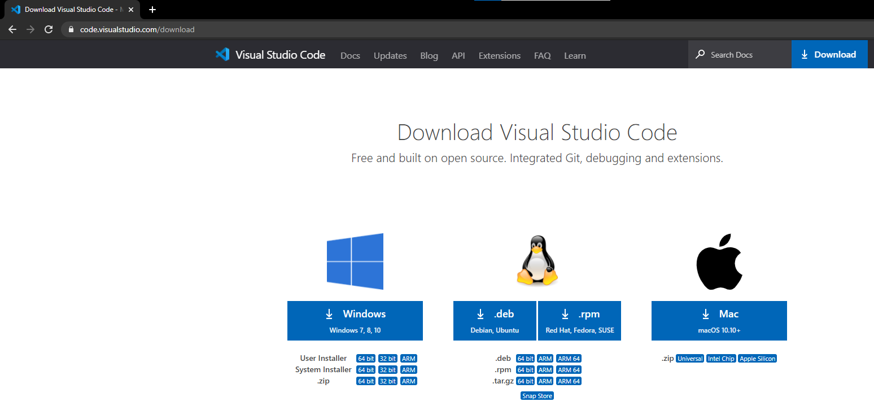
Installation – VS Code
https://code.visualstudio.com/download

Slide 16
Creating Project in Django
django-admin startproject project_name

Slide 17
New Project Layout
project1/
project1/ //project sub-folder, the entry point for the website
__init__.py //an empty file that instructs python to treat this directory as a python package
settings.py //contains all the website settings
urls.py //defines the site URL-to-view mappings
wsgi.py //helps django application communicate with the webserver.
manage.py //script used to create applications, work with databases, and start the
development web server.

Slide 18
Creating App in Django
django-admin startapp app_name

Slide 19
New App Layout
project1/
project1/… //project sub-folder, the entry point for the website
projectapp/ //application folder
migrations/ //sub-folder used to store "migrations" - files that allow you to automatically update
your database as you modify your models
__init__.py //an empty file that allow you to use its objects within other parts of the project
admin.py //stores administration site configuration
apps.py //stores application registration
models.py //stores models
tests.py //stores tests
views.py //stores views
manage.py //script used to create applications, work with databases, and start the
development web server.

Slide 20
Run Server
python manage.py runserver

Slide 21

Personal News App

Slide 22
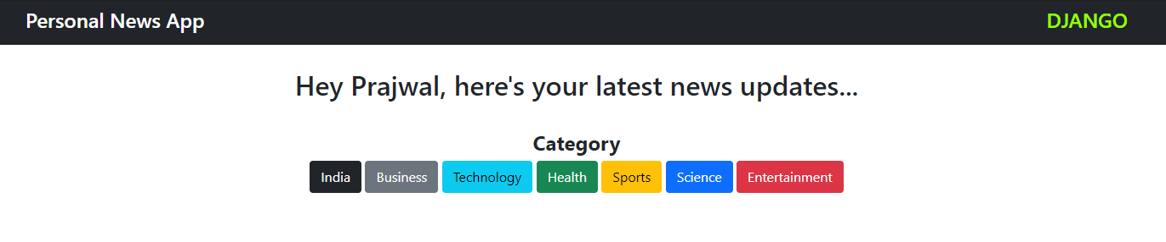
Customized News Feed
All your News Updates at one place
Category-Based Feed

Slide 23
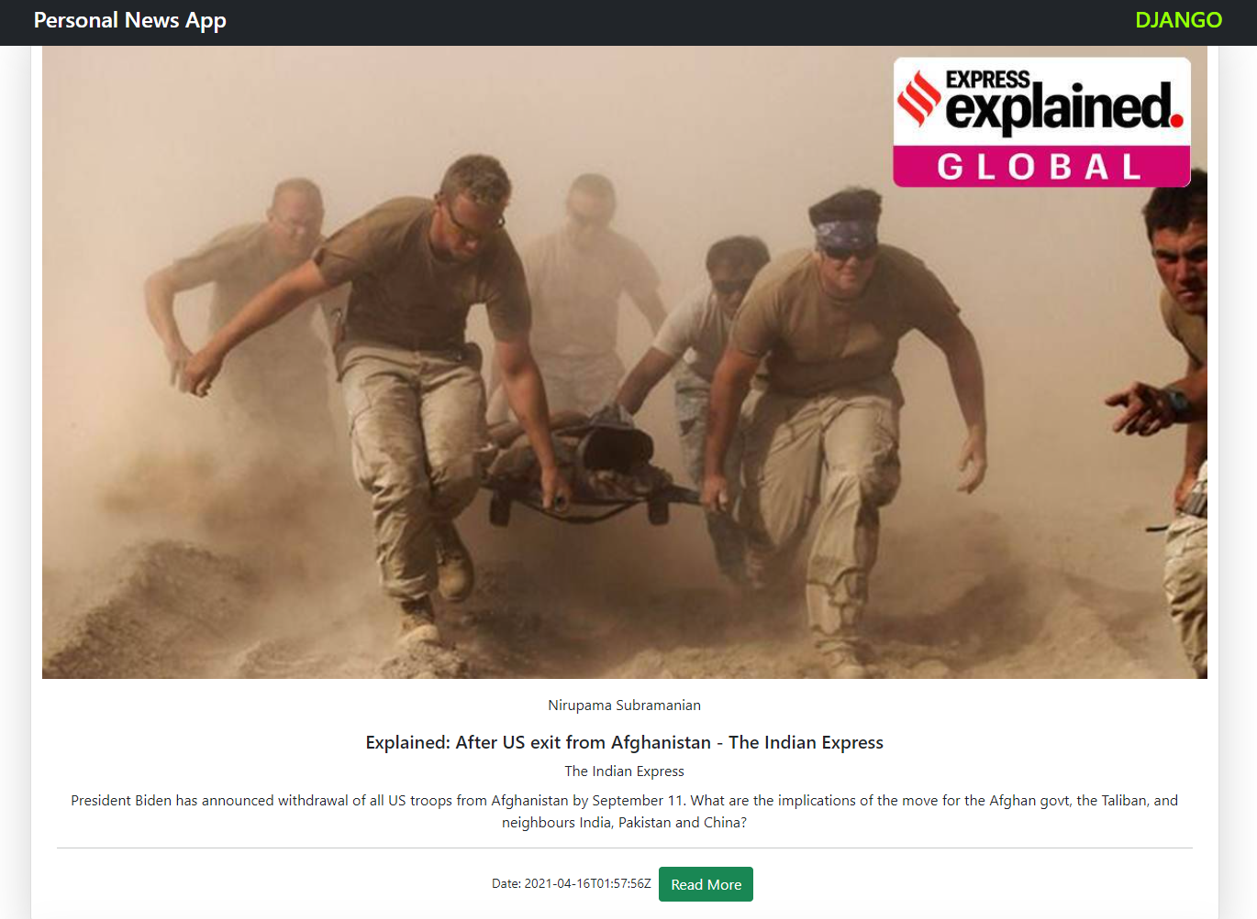
Image
Image
Editor
Headline
News Source
Short Description
Date
Read More…

Slide 24
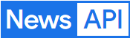
News API is a simple HTTP REST API for searching and retrieving live articles from all over the web.
We can search for articles with any combination of the following criteria:
- Keyword or phrase
- Date published
- Source domain name
- Language
Supports various Client libraries like Node.js, Ruby, Python, PHP, Java, C#

Slide 25
References
http://www.djangoproject.com/
For more information on Documentation, Download and News
http://www.djangobook.com/
A good book to learn Django
https://newsapi.org/
Retrieve news articles from around the world
https://getbootstrap.com/
Quickly design and customize responsive websites

Slide 26


